Slide 1
MACHINE LEARNING

Slide 2
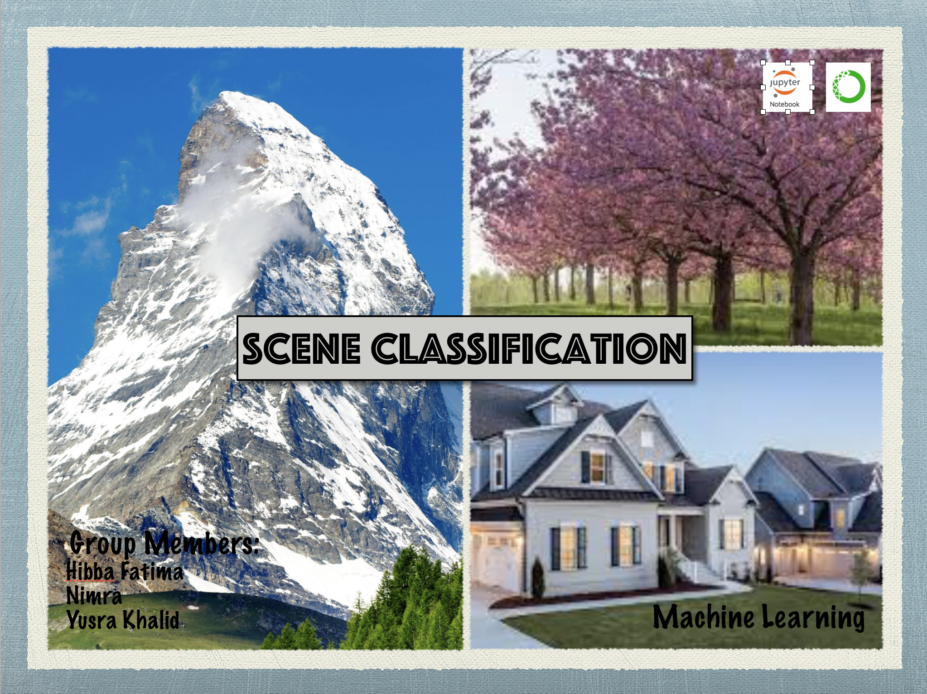

Slide 3
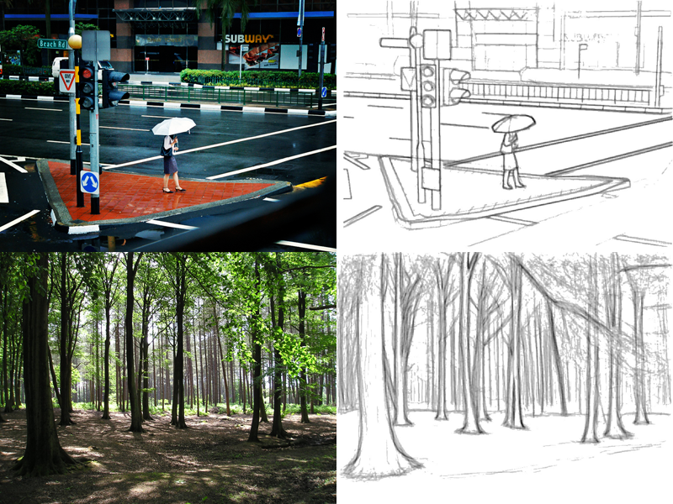
Project Idea
In our project, we are doing scene classification to categorize images into different classes. Scene classification uses the layout of objects within the scenes and not only focuses on objects itself.

Slide 4
Categories
We are categorizing our images into 5 classes.
Mountains
Oceans
Treas
Houses
Laptops

Slide 5
Data Collection
Data is collected from google Images as the available datasets on the different datasets were too big or already trained.
The Image names along with labels for training are stored in csv file which is read by pandas framework
The Image names for testing are also stored without labels in csv file
The real images are stored in folders named train and test.
The total Images for training set are 438.
The total Images for testing set are 33.

Slide 6
Image Pre-Processing
Reading Images
Images loaded in 28x28 pixels and in RGB format
Image converted in 3 dimensional array
Image Normalization
Each Image is being stored in an np.array
The labels of images are read and is stored in the form of binary matrix

Slide 7
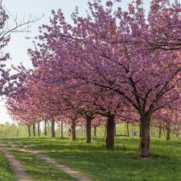
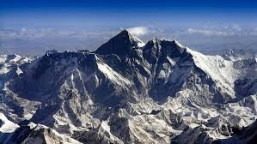

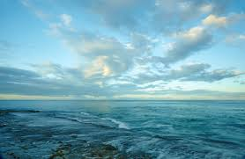
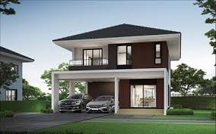
Classes

Slide 8
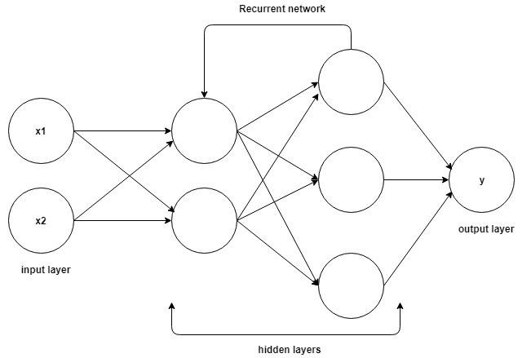
Classification Model
We have applied Recurrent Neural Network for model generation
Sequential model
8 layers

Slide 9


Libraries Used
Numpy
Pandas
Sklearn.model_selection
Matplotlib.pylot
Keras
tensorflow

Slide 10


Technologies Explored and Improvements
Google Colab
Online google hosted server for development of ML
Has some datasets available
Has a large number of libraries installed
Inception
Already trained models available

Slide 11
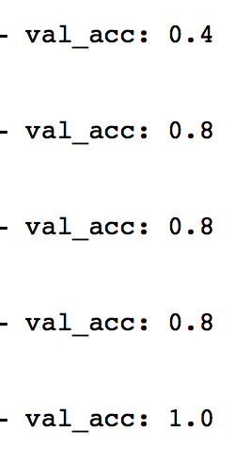
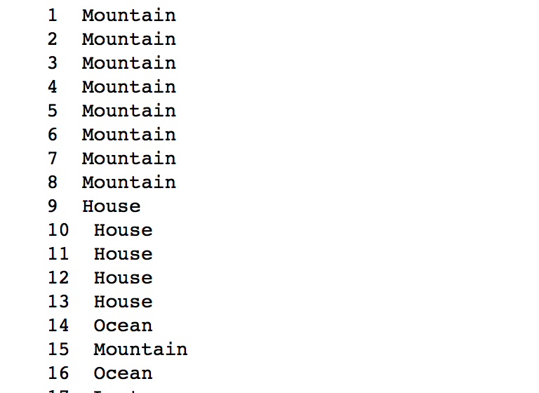
Results and findings
Our calculated accuracy was around 80%
By increasing number of images, we can have even greater accuracy.
The accuracy improved from 40 % to 80 % as images increased from 45 to 439
Our model gives better accuracy for rgb images compare to grayscale

Slide 12
Demo

